Slide 1
Docker Swarm
Sameer Zulfi

Slide 2
2 Major Components
A Cluster
An Orchestration Engine

Slide 3
On the Clustering front
A swarm consists of one or more Docker nodes
These can by physical servers, cloud instances etc.,
Nodes are configured as Managers and workers
Managers = Control Plane
Workers = execute the tasks
Configuration and state of the swarm is stored in etcd database which is located on all the managers

Slide 4
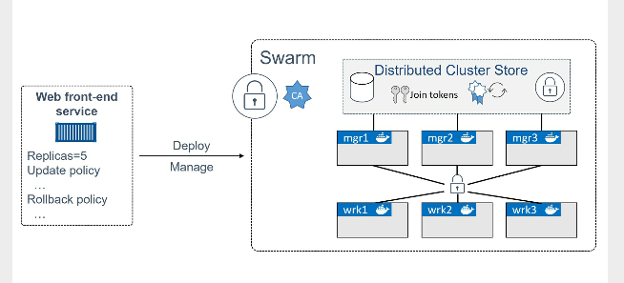
High-level Swarm

Slide 5
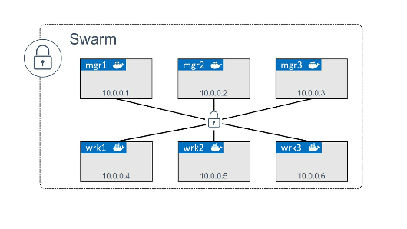
Build a Swarm Cluster
WE will build a swarm cluster with 3 manager nodes and 3 worker nodes

Slide 6
Each of the nodes needs Docker installed.
You should have following ports open on routers and firewalls
2377/tcp : for secure client to daemon communication
7946/tcp/udp : for Control Plane Gossip
4789/udp : for OverLay Networks
Process of building a swarm sometimes we call it as “Initializing a Swarm”

Slide 7
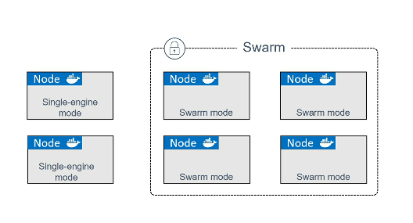
Initializing a brand new Swarm
Docker nodes that are not part of swarm , we call it as Single-engine node
Once they are added to the swarm, they are switched into Swarm mode.
Running “docker swarm init” on the Node1 will make that node as the first manager of
The swarm

Slide 8
Additional nodes then can be joined as workers or managers.
Following are the steps:
Create 6 aws ec2 instances and tag it as mg1,mgr2,mgr3,wrk1,wrk2,wrk3
Make sure docker is installed on all the machines.
Login into mgr1 : and initialize the swarm by “docker swarm init”
Then login to wrk1, wrk2 & wrk3 to join them as worker nodes
Then login to mg2, mgr3 to join them as additional manager nodes
At any moment, you try to run this command from any manager nodes :
docker node ls
It will list out how many nodes are swarmed.
Among Managers, they will choose one Leader

Slide 9
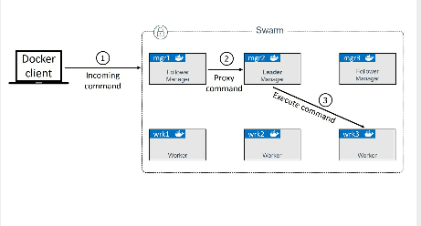
A Leader among the Manager

Slide 10
Services in Docker Swarm
Run the below command
docker service create –name web-fe –p 8080:8080 –replicas 5 awssameerzulfi/dockerciwebsite
We are declaring a new service which needs to be deployed onto this Swarm.
We told Docker to map port 8080 on every node in the Swarm to 8080 of each service
Next we informed Docker that there should be 5 replicas/tasks/containers should be running of this image
After hitting Enter, Manager acting as a Leader will initiate 5 replicas across the Swarm.
Remember that Swarm Managers sometimes act as Workers

Slide 11
Autolock Feature
This feature forces the Managers that have been restarted to present the cluster unlock key before being permitted back into the cluster
If you have already initialized the swarm, then you can run the below update command
docker swarm update –autolock=true
If you are initializing the swarm with autolock, you can do
Docker swarm init –autolock=true
Please remember to store this key in a password manager, since without it you will not be able to restart the manager

Slide 12
Service docker restart
Try and list the nodes in the swarm
Docker node ls
You will get an error response from daemon.
Although the Docker service has restarted on the manager, it has not been allowed to re-join the cluster.
You need to run this below command on the restarted manager.
Docker swarm unlock
Locking your swarm and protecting the unlock key is recommended for production environments

Slide 13
Viewing and inspecting services
Docker service ls
Docker service ps web-fe
Docker service inspect –-pretty web-fe

Slide 14
Scaling a Service
Let’s assume business is booming
We are seeing lot of traffic hitting our website.
You need to simply execute the below command
Docker service scale web-fe=10
That’s it… it’s scaled from 5 replicas to 10 replicas
Run this command to check
Docker service ls
Docker service ps web-fe
Let’s try this command
Docker service scale web-fe=5
We scaled down again

Slide 15
Removing a Service
Docker service rm web-fe
Confirm it’s gone
Docker service ls
Be careful with this command, it deletes all service replicas without asking for confirmation

Slide 16
Rolling updates
Pushing updates to deployed applications is the production scenario. This is what happens.
We need to create a new network first.
Docker network create –d overlay uber-net
The above command creates an overlay network and name of the network is “uber-net”
Run a “docker network ls” command to check whether “uber-net” created?
Let’s create a new service and attach it to this “uber-net” network
Docker service create –-name uber-svc --network uber-net –p 80:80 –replicas 12 nigelpoulton/tu-demo:v1

Slide 17
Run the below command to verify the state of the new service
Docker service ls
Docker service ps uber-svc
I hope you guys are aware of the Ingress Mode.
Let’s execute the below command
Docker service update –-image nigelpoulton/tu-demo:v2 –update-parallelism 2 –update-delay 20s uber-svc
We gave the new image tag v2 which is the updated image and we used update parallelism and update delay flags to make sure that the new image was pushed to 2 replicas at a time with a 20 second cool-off period.
Try to execute this command
Docker service ps uber-svc
You can witness the update happening in real-time by opening a web browser to any node in the swarm and hitting refresh several times.
Docker service inspect –pretty uber-svc

